Slide 1
COVID-19 Cases-part-3
File created on: 28-03-2020 15:06:02

Slide 2
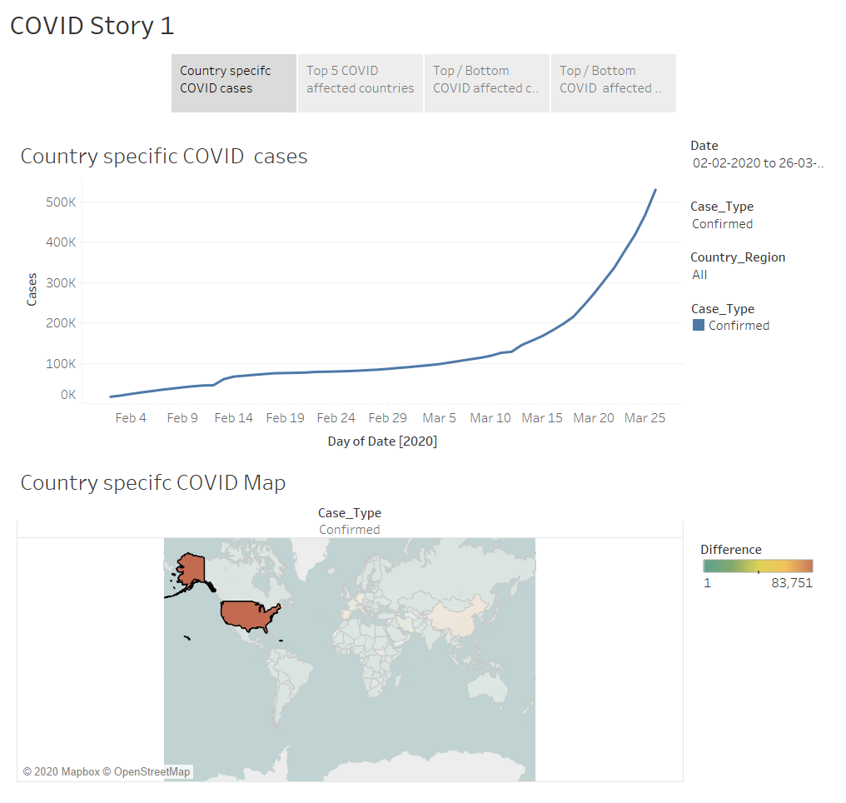

Slide 3
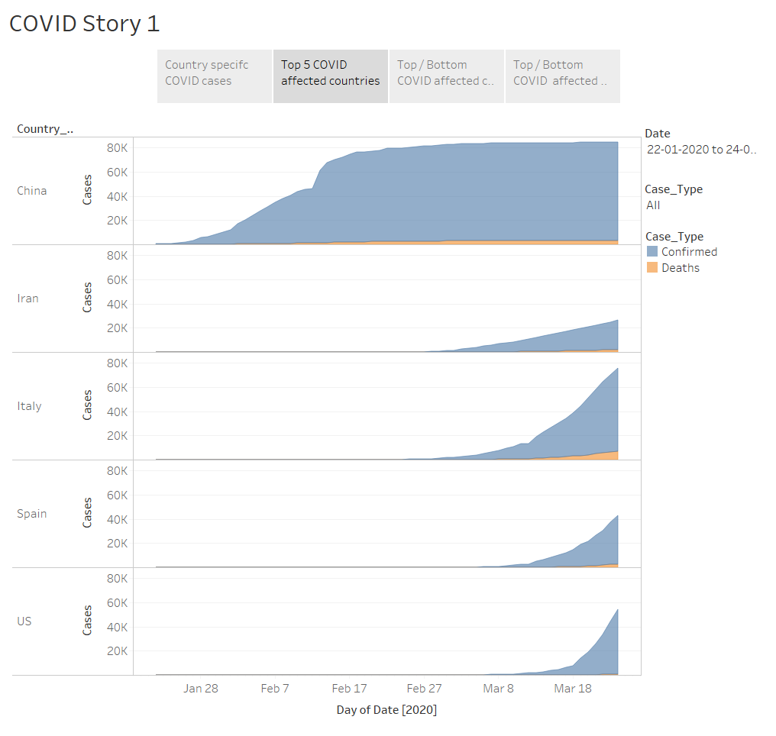

Slide 4
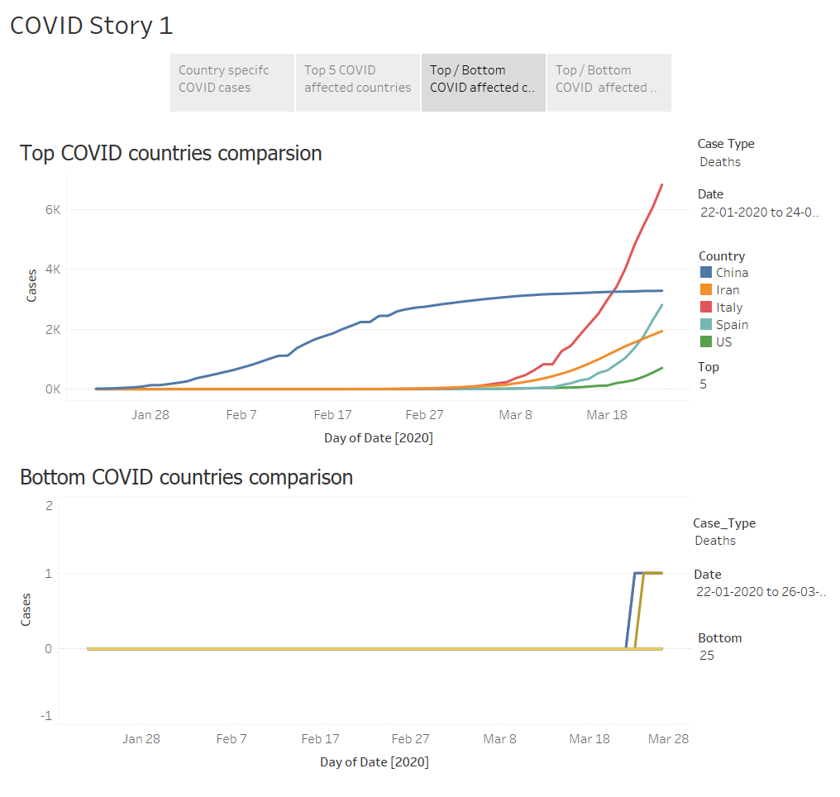

Slide 5
